Slide 1

ST1508
Practical AI
CA1
Group1: 2235189 Wang Zi Xin
2222291 Toh Kien Yu
2222329 Goh Rui Zhuo

Slide 2
Background
Gobest Cab has hired our data science team to create an intuitive and user-friendly machine learning software application that aims to help them visualise and analyse cab data.
The company desires a portable application that can operate on the manager’s laptop. GoBest Cab’s management has requested our data science team to construct an interactive dashboard to give insights into driver behaviour, distinguishing between safe and dangerous drivers.

Slide 3
Business understanding
Improvement of safety
Enhance safety by identifying and analysing driver behaviour
Involves distinguishing between safety and dangerous trips and analyse various data such as acceleration in a trip
Interactive Dashboard
Important to create an intuitive, user-friendly application
Present information and analytics in a clear and easily understandable format
Data-Driven Insights
Focus on utilising cab data collected during trips to extract meaningful insights
Provide Business Impact
Utilising the insights to have an actionable steps
Improve on the overall safety standards of GoBest Cabs

Slide 4
Data understanding
Sensors dataset
In the sensor dataset, it contains the telematics data from speed to accuracy
Dataset is split into 5 different files and with a total of 7 million dataset
This dataset is useful in identifying the trend
Drivers Data
Contains the driver information from name to rating
Understand which driver is driving dangerously
Suitable to provide insights of which driver to alert of dangerous driving
Safety Labels
Provide the labels of dangerous and safe driving
Contains booking ID for linking of foreign key with the sensor table

Slide 5
As a Manager:
I need an intuitive application with a user interface so that I can visualise, analyse, and compare cab-driving data such as the telematics data on trip safety and make informed decisions.
Confirmation
Acceleration distribution can be seen in the dashboard.
Speed base of each driver can be seen.
Info is well readable by the user.
Able to seamlessly identify dangerous trips.
I want to be able to do a comparison between different drivers so that I can compare between different drivers in visualisation to spot patterns of dangerous driving habits.
Confirmation
User friendly interface for seamless user interaction
Retrieve historical trends.
System capability to detect anomalies in driver behaviour.
Ability to select driver

Slide 6
As a Cab Driver:
As a cab driver, I want a model that can predict the safety and unsafety of a trip so that I can notify the driver to beware and be more cautious when driving.
Acceptance Criteria:
The accuracy of prediction should be high
It should be able to provide real time prediction for trip safety
The model should consider a wide range of relevant data that contribute to travel.
I want to have a personalised dashboard where I can view statistics such as my driving ratings and safe driving so that it improves the passenger's experience.
Confirmation
Drop down menu provided for different options
All the information which appears in dataset can be found in dashboard
The dashboard should be interactive and have user-friendly interface (added colour style)

Slide 7
As an Administrator:
I want to be able to ensure and efficient access to data related to driver’s performance and safety metrics, so that business analysts can effectively monitor safety and identify trends.
Confirmation
Database contains safety metrics such as safety labels with other information such as speeds.
Databases are well designed with proper primary key and foreign key

Slide 8
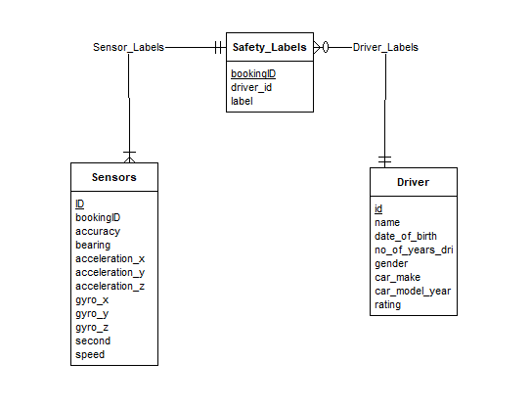
Database Operation
Database Design
With three tables of Sensors, Drivers and Safety Labels, there is a need to link the tables together
Sensor will have a separate unique identifier key as its primary key with booking ID as foreign key
Drivers will have driver id as the primary key
Safety Labels will have the booking ID as the primary key with foreign key driver id

Slide 9
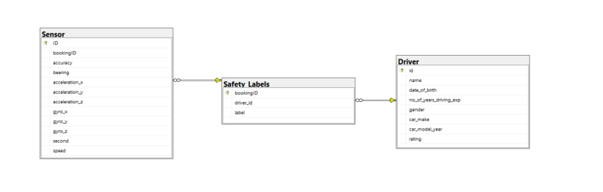
Database Operation
Database Insertion
Creation of table with the use of create statement in SQL
Insert statement was created with the use of bulk insert
Database was successfully created with proper primary and foreign key

Slide 10

Query 1
Query 1: Get the percentage of dangerous trips for each vehicle age group and important information with average speed (Appendix 1 )
Idea behind is to provide information on whether each age group of car has a higher percentage of dangerous trips
This is so that if higher age group generally has a higher percentage of dangerous trips, we are able to identify some causes and solve the problem

Slide 11
Query 1 Results
Insights
From the result, we can see that between 11 and 15 years of car age, it has the highest percentage of dangerous trips at 25.4%
However, the mean sped is actually lower and the mean rating by each group are generally still in the middle
Also, we can see that majority of the trips are operated with majority over 15 years, showing that the cars are at a older age

Slide 12

Query 2
Query 2: Group the total duration by interval, and analyse the danger percentage during that interval itself
Idea behind is to provide information on whether a longer trip has a higher percentage of being Dangerous
This is so that if higher trip duration group generally has a higher percentage of dangerous trips, we are able to identify some causes and solve the problem

Slide 13
Query 2 Results
Insights
From the result, we can see that between 11 and 20 mins, it has the highest total trips at 9034 with 30+mins the leats
However, we can see that in those that are 30 or more mins, it has the highest percentage at 73.2% showing that the this duration has to be look and manage especially for longer trips

Slide 14
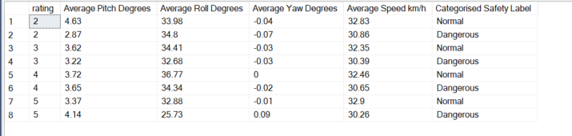
Query 3
Query 3: Analyse the pitch, roll and yaw by the safety labels
Idea behind is to provide information of the pitch , roll and yaw of the driver
This is so that we are able to analyse the different statistics for pitch, row and raw and determined between each rating is there any major difference between the label

Slide 15
Query 3 Results
Insights
Average pitch degrees of normal are higher compared to dangerous at 3.71 compared to 3.5.
Average roll degrees of normal are higher compared to dangerous at 34.84 compared to 32.04.
Average yaw degrees of normal are lower compared to dangerous at -0.02 compared to -0.01.
Across all metrics, it seems that generally the raw pitch and yaw did not exactly resulted in the classification of safety labels

Slide 16
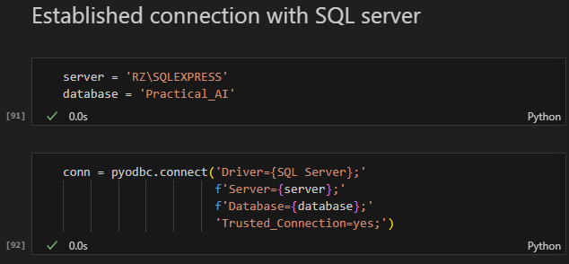
ETL Pipeline
Etl pipeline:
Connect to SQL server:
Utilising pyodbc to integrate the dataset into python jupyter notebook
Figure 6: Code for the ETL
pipeline

Slide 17
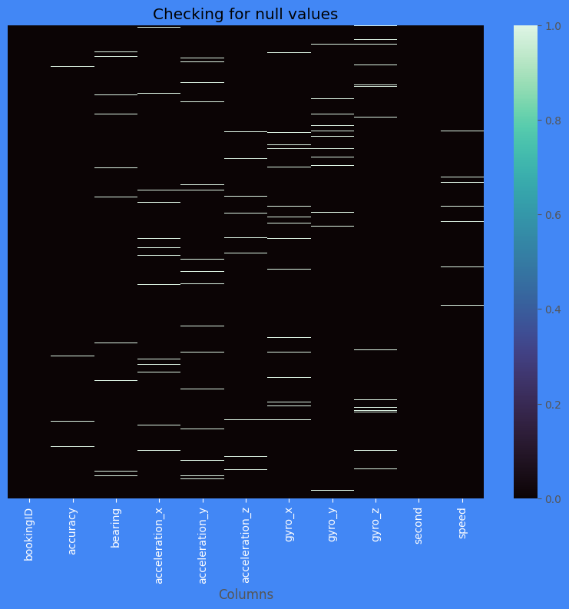
Data Preprocessing
Check for null values:
Null values was check for each dataset with the use of pandas
Sensor dataset contains null values while the other two dataset did not contain null values
Additional check for sensor dataset
Insights:
For sensor dataset, majority of the null values can be seen in almost all columns and occurs at random with no observable pattern

Slide 18
Check for Correlation between each variable to determine imputation methods
Data Preprocessing
Insights
For both of the datasets, there is no clear correlation between the variables and the best is just a moderate correlation
Imputation of all columns
Stochastic Imputation was used
Aims to reduce the bias by an extra step of augmenting the predicted score with a residual term
Residual term is normally distributed with mean zero and variance equal to residual variance
Useful when missing values occurs at random

Slide 19
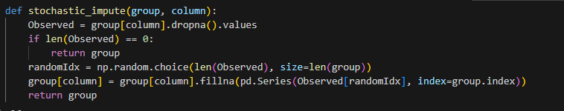
Data Preprocessing
Drop rows where seconds is null
Because of the nature seconds is, it is not viable to impute seconds as we do not know the correct order of it
Dropping those rows is the best option here
Residual term is normally distributed with mean zero and variance equal to residual variance
Useful when missing values occurs at random

Slide 20
Exploratory Data Analysis
Analysing on the acceleration column
Utilised Plotly Go to plot out the graph
Insights
For the acceleration data, we can see that x is symmetrical, y is negatively skewed and z is symmetrical, all contains outliers
However, outliers may not be able to drop due to the fact that it can affect the overall data
Analysing on the gyro columns
Insights
For the gyro data, we can see that x is symmetrical, y is negatively skewed and z is symmetrical, all contains outliers
However, outliers may not be able to drop due to the fact that it can affect the overall data

Slide 21
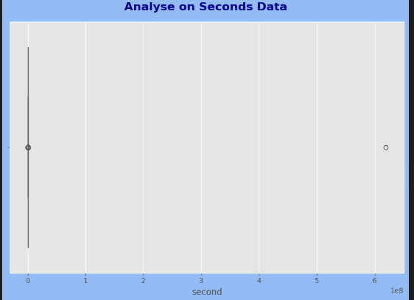
Exploratory Data Analysis
Analysing on the other columns
Insights
For the other columns, we can see that bearing is symmetrical, accuracy is negatively skewed and speed is symmetrical, all contains outliers
However, outliers may not be able to drop due to the fact that it can affect the overall data
Analysing on the second column
The seconds column is separated out to analyse on the second dataset due to the nature of the data

Slide 22
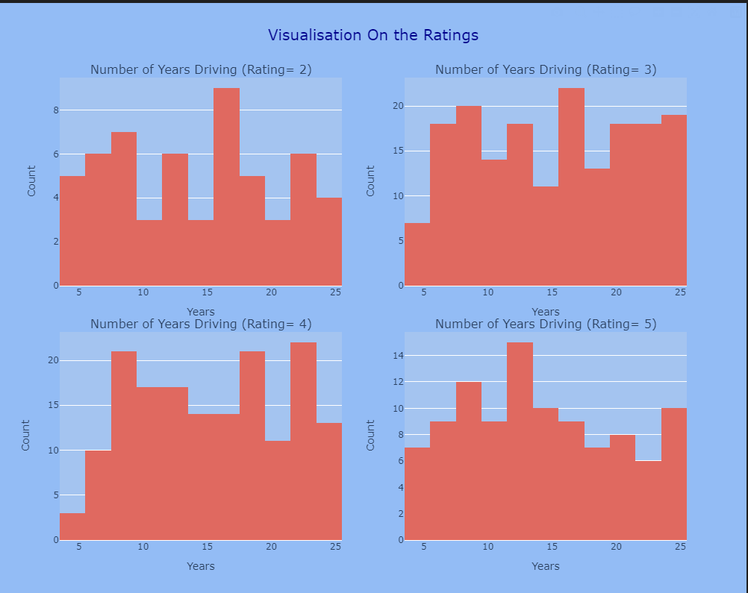
Exploratory Data Analysis
Analyse the Years Of Experience with respect to Rating
This is to analyse the distribution of experience base on the rating the driver has
Insights:
For the rating 2, we can see that 15 to 16 years has the highest count
For the rating 3, we can see that 15 to 16 years has the highest count
For the rating 4, we can see that 23 to 24 years has the highest count
For the rating 5, we can see that 12 to 13 years has the highest count

Slide 23
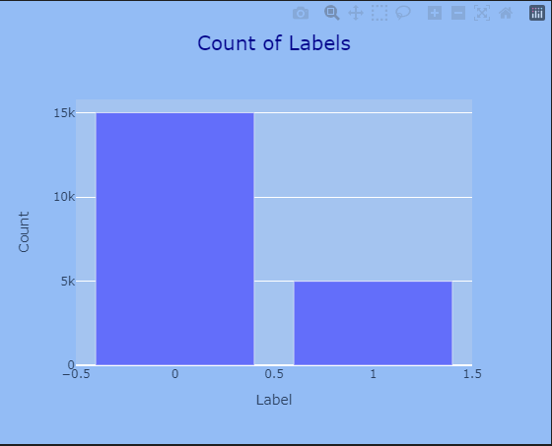
Exploratory Data Analysis
Analyse the Years Of Experience with respect to Rating
This is to analyse the dataset in terms of car makes and the gender
Insights
For the car make, we can see that Toyota has the highest count and Mitsubishi has the lowest count
For the gender, the male has a higher count than the female
Analyse the count of each label
This is so that we know how the dataset looks like in terms of number of counts for each class
Insights:
We can see that there is more 0 labels as compared to 1 label in the dataset, showing an imbalance of class

Slide 24
Analyse the Distribution by labels
This is to analyse on all the columns with respect to the labels
Insights
Distribution across all labels and columns are about symmetrical with the count around the same
Analyse on top 5 with the most dangerous trips
This is to analyse the top 5 most dangerous trips by the driver id of the driver
Insights
Driver id 252 441 133 150 479 are part of the top 5 which has the most dangerous trips
Detect outlier of second data
This is to detect the outlier in the seconds data to determine how much to drop
1 day is the limit for the trips and therefore anything more than that will be removed
Exploratory Data Analysis

Slide 25
Feature Engineering
Dropping speed which is negative
The negative speed are being drop off due to it being unrealistic to have negative speed
Feature Extraction the new columns base on speed
New columns base on speed will be created to provide more possible columns for visualisation in tableau
Mean, Median, Standard deviation , max and distance will be feature extracted
Total Duration of Each Trip
Total duration of the trip was got through group by and get the total duration
Then it is converted to mins

Slide 26
Feature Engineering
Car Age Bin and Age Bin
With the use of KBinsDiscretizer, the age and car age bin was bin into 5 different bins and then categorise into low and high etc
This is to provide analysis on age category for visualisation and not just the age
Get the Pitch, Roll and Yaw
Pitch: Rotation around the vehicle side to side axis, it indicates the up or down angle of the nose, experience when accelerating or braking
Roll: Refers to rotation around the vehicle front to back axis, felt through turning
Yaw: Rotation of the vehicle around the vertical axis which runs from top to bottom the vehicle

Slide 27
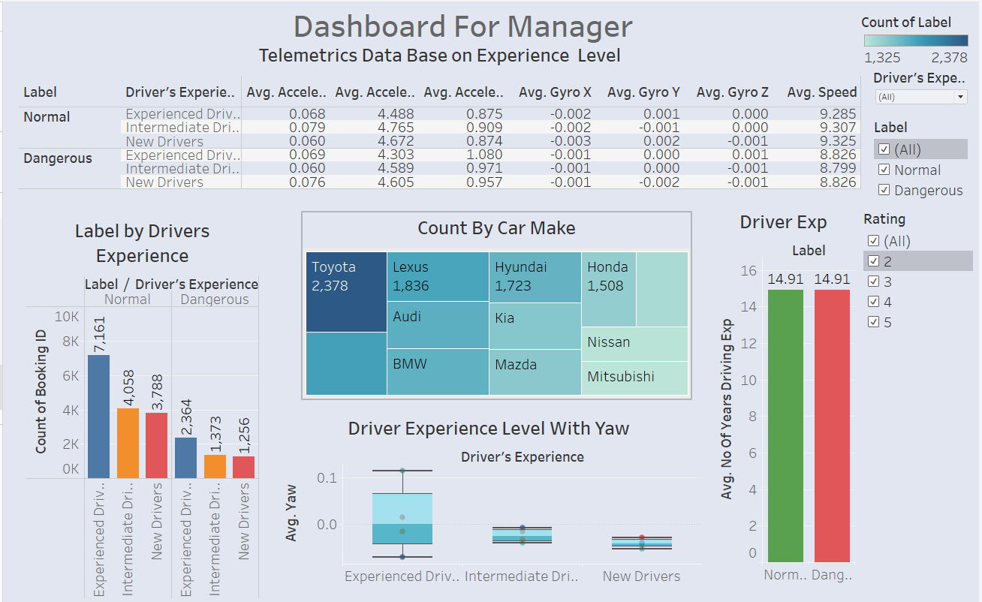
Dashboard 1
Dashboard 1 allows managers to visualise, analyse, and compare cab-driving data such as the telematics data on trip safety and make informed decisions.
Manager is able to customise cab driver’s based on car make, safety label and driver’s experience for analysis.
It can be seen that most drivers are experienced and drive Toyota.
A box and whiskers plot was made to analyse the yaw experience based on their driving experience. The newer drivers are more conservative have a smaller yaw which means smaller rotations between turns whereas the more experienced drivers are more ‘daring’, having a larger yaw which suggests a difference in driving behaviour.
In addition there is a bar plot to compare between the average years of driving experience

Slide 28
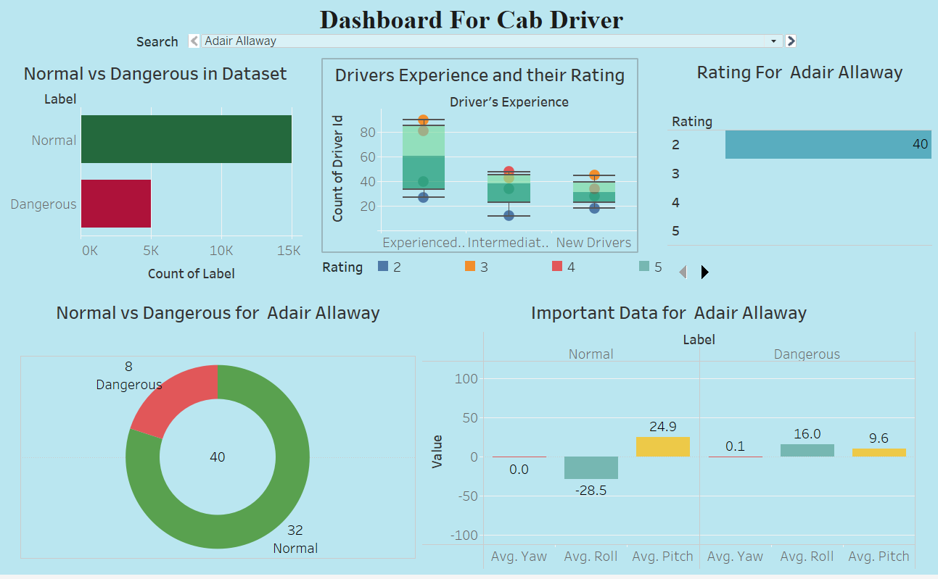
Dashboard 2
Dashboard 2 shows the information about the rating of the driver and the trip he takes.
It provides a comparison between normal and dangerous in the dataset for all the drivers, we can see that there is a higher count of label 0 which is Normal
Driver can check his experience level , rating , percentage of safe and dangerous trip and some important data by put his name in dropdown menu, this give insights on how the experiences of drivers might correlate with satisfaction of the customer
Even the driver with the rating of 2 , 80% of the trip ate safe

Slide 29
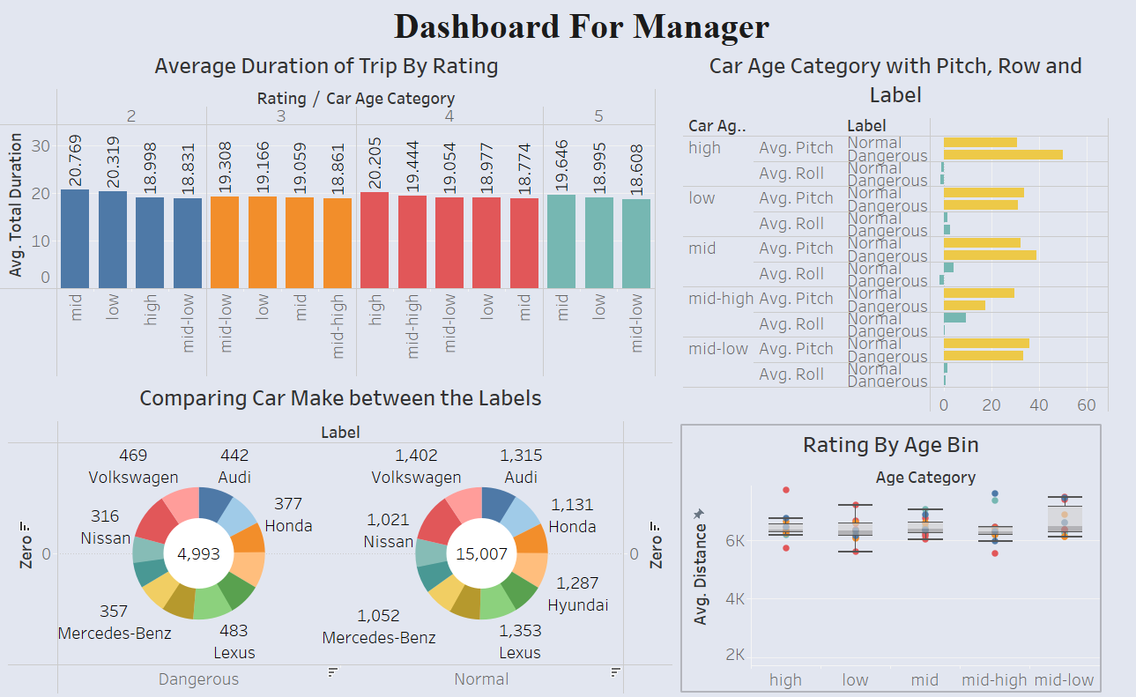
Dashboard 3
Dashboard 3 provides more in depth analysis on the different car make for managers to delve deeper into.
The average duration of trips was also compared based on the cab driver’s rating
Average duration of trip with respect to rating to provide how the age of the car might affect the length of trips and the rating receives
A donut chart was plotted out to sieve out the count of different car makes between safe and dangerous drivers which helps the manager to see which one are more associated with each safety category and to make a suggestion to the upper management

Slide 30
Conclusion
In conclusion, our team has developed 3 dashboards for GoBest Cab for managers and cab drivers to utilise based on their different needs. We placed ourselves in the shoes of these users when utilising our product to ensure high standards of our work.
Through this project, we learn about the different processes of a data science project. At the start, we learn about database designing, creation of query and pipeline followed by doing Data cleansing and data preprocessing. In addition, additional analysis with Plotly was tried and created
Overall, the dashboard provided a good analysis to fulfil the user story of users manager and drivers with the database design fulfilling the database administrator.

Slide 31
Student Name | Percentage of Contribution
Goh Rui Zhuo | 43
Toh Kien Yu | 34
Wang ZiXin | 23

